Slide 1
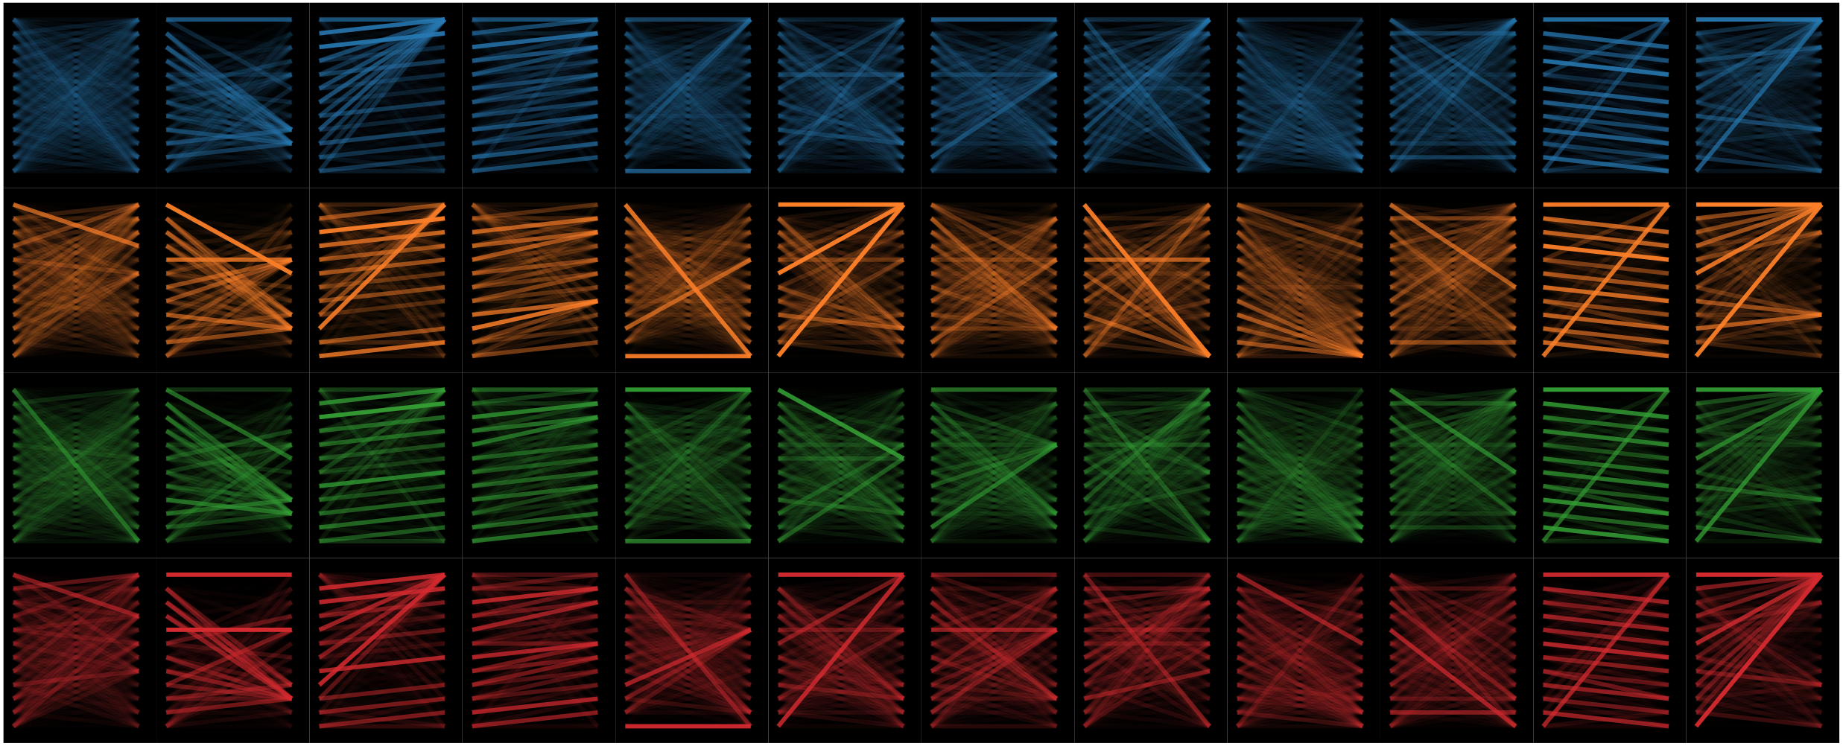
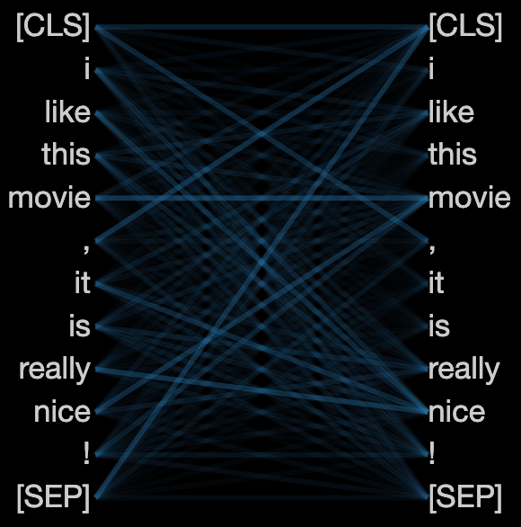
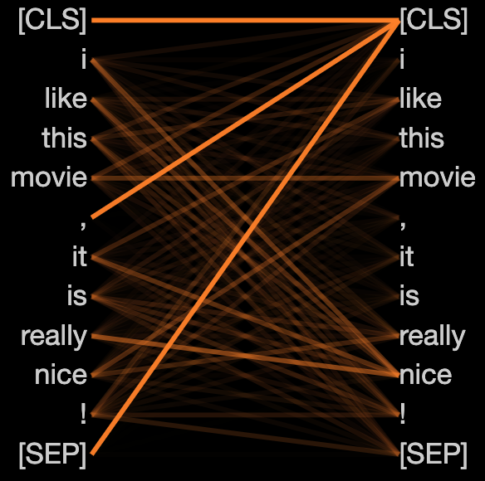
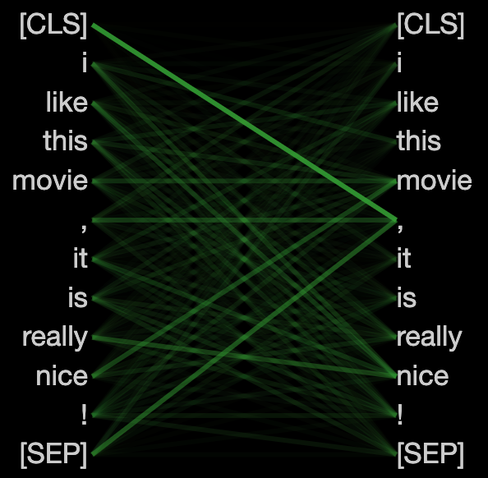
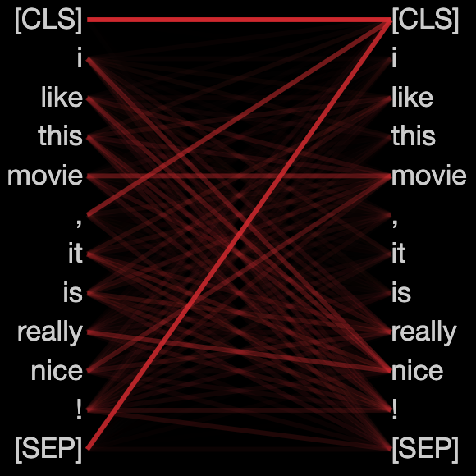








Heads
1
2
3
4
5
6
7
8
9
10
11
12
$$f$$
$$f^{1}$$
Models
$$f^{2}$$
$$f^{3}$$
Model $f$, Head 6
Model $f^{1}$, Head 6
Model${ f}^{2}$, Head 6
Model${ f}^{3}$, Head 6

Slide 2



$$a^{1}$$
$$a^{3}$$
$$a^{2}$$

Slide 3








Scaled Dot-Product Attention
$$H$$
$$V$$
$$K$$
$$Q$$
$$⨁$$
$$⨁$$
Plugin
$$Model$$
$$id$$
Linear
Linear
Linear
Linear
Linear
$$\tilde{h}$$

Slide 4












Normal Example
Adversarial Example
Perturbation Space
$$vote=1$$
$$vote=1$$
$$f^{1}=1$$
$$f^{2}=0$$
$$f^{3}=1$$
$${id=1, f}^{1}=1$$
$${id=2, f}^{2}=0$$
$${id=3, f}^{3}=1$$
Model 1
Model 2
Model 3
Base
Plugin
$$Model$$
$$id$$
$$x$$
$$x$$
Basic Ensemble
Ours

Slide 5



















Normal Example
Adversarial Example
Perturbation Space
$$vote=1$$
$$vote=1$$
Scaled Dot-Product Attention
$$H$$
$$f^{1}=1$$
$$f^{2}=0$$
$$f^{3}=1$$
$${id=1, f}^{1}=1$$
$${id=2, f}^{2}=0$$
$${id=3, f}^{3}=1$$
$$V$$
$$K$$
$$Q$$
Model 1
Model 2
Model 3
Base
$$⨁$$
Plugin
$$⨁$$
Plugin
$$Model$$
$$id$$
Liner
Liner
$$Model$$
$$id$$
Liner
Liner
Liner
$$x$$
$$x$$
Basic Ensemble
Ours
$$\tilde{h}$$

Slide 6








Normal example
Adversarial example
Perturbation space
Model 1
$$f^{1}=1$$
Model 2
Base
$$x$$
Plugin
$$Model$$
$$id$$
$$f^{2}=0$$
$${id=2, f}^{2}=0$$
$${id=3, f}^{3}=1$$
Model 3
$$x$$
$${id=1, f}^{1}=1$$
$$f^{3}=1$$

